Slide 1


D. Y. Patil College of Engineering Department of Information Technology
Audit Course Presentation
On
“Vehicle Interface and Accident control using IOT”
Project Group Members:
T1751108 , Abuzar Tamboli
T1751107 , Sakshi More
T1751112 , Satyam Jaimini
T1751119 , Kasturi Pokharkar
T1751124 , Ganesh Karale
Day and Date of Exam : Saturday, 22 May 2021

Slide 2
CONTENTS
Introduction.
Project Motivation.
Aim/Objective.
Overview of the Project.
System Overview
Advantages.
Conclusions.
References.

Slide 3
INTRODUCTION
With the increase in demand for smart intelligent devices, integration of smart systems in automobiles is inevitable and certainly has gained large attention in recent times.
To develop the intelligent smart systems, installing vehicle sensors and processing data from them is the key fundamental step.
This presentation provides overview of how to capture certain critical vehicle data from various sensors and process the data which can later be processed for intelligent systems development and to display the relevant information for the rider.

Slide 4
MOTIVATION
The current automobile industry is struggling with the issue of lack of information about the performance of product and its sub systems during its usage, which can later be used for future product development or improving the current product or sub systems. This is mainly due to the fact that the collection of data from sub systems of gasoline vehicles is hectic and processing such large chunks of data is not possible.
With the advent of IOT vehicles and owing to its simplistic design and lesser number of parts one can collect large amounts of data from the vehicle and use it for further research. With cloud connectivity, this data can be transmitted at real time and this paves way for an entirely new era in the transportation sector leading to intelligent connected transportation systems.

Slide 5
AIM OF THE TOPIC
The aim of this project is to provide a digital interface and safety measures for the motorcycle using IOT.
The project also aims at:
Rider’s Safety: Detecting the side stand by using Side stand alarm indicator and sensors.
Digital Speedometer: Instead of the analog speedometer we see in today’s two wheeler vehicles, a digital speedometer will be provided in the interface.
Speed Barrier: The speed barrier will trigger if the vehicle is in a crowded place.

Slide 6
OBJECTIVE
The prime objective of this project is to develop a module
which can collect data from vehicle sensors like speed, GPS
information and motion tracking using accelerometer and
gyro sensor and log the data onto a database file.
The information collected is used to display ride metrics
information onto a display dashboard on the vehicle.
The Bike Side stand unfolded ride lock link for two wheelers is the one of the lifesaving mechanism, which prevents the ride from riding the bike in unreleased position (retracted position) of the side stand.

Slide 7
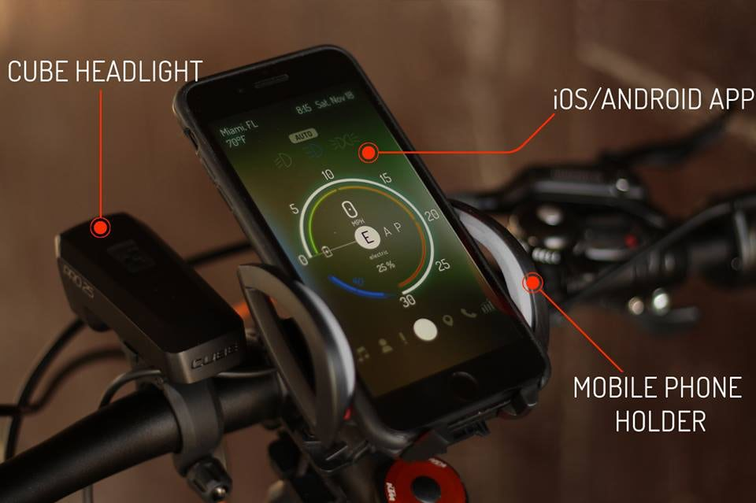
SYSTEM OVERVIEW

Slide 8
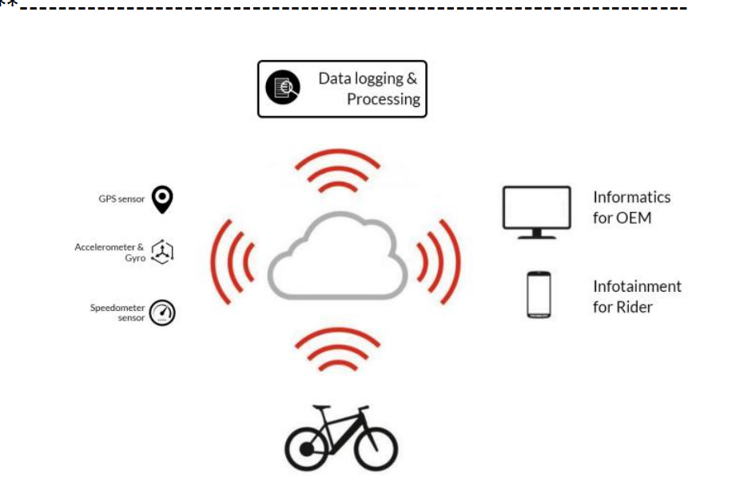

Slide 9
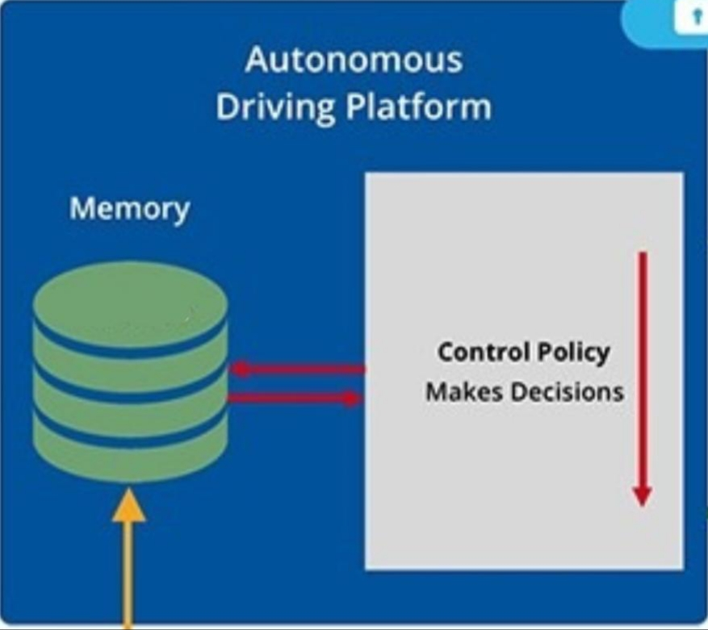
GPS | Fuel Sensor | Accelerometer | Speedometer
Battery Sensor | Odometer | Gyro Sensor | Side-Stand
Component 2
(Processing)
Component 1
(Inputs)
Component 3
(Output)
Safety Systems | Driver Monitoring | Mapping Systems | GPS Tracker
Object/Crowd Detection | Side-Stand Buzzer | Speed Barrier | Battery/Fuel Status

Slide 10
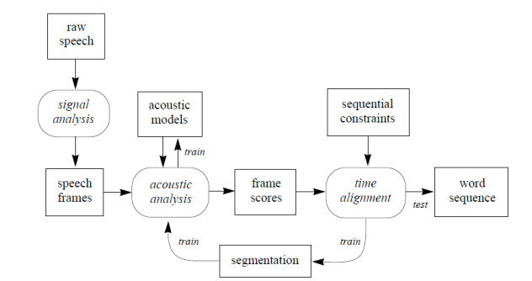

Sensor Data
Workflow

Slide 11
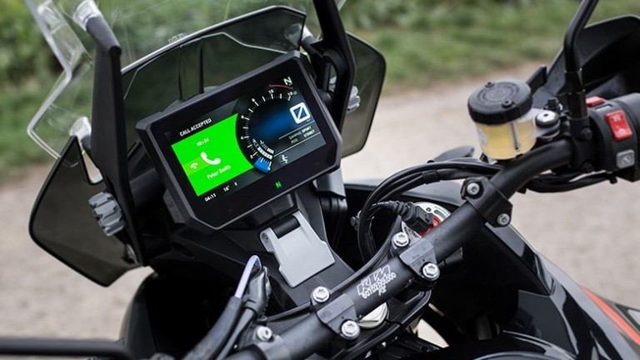
DIGITAL INTERFACE
DIGITAL INTERFACE is the medium through which humans interact with computers. Interfaces represent an amalgamation of visual, auditory, and functional components that people see, hear, touch, or talk to as they interact with computers (digital devices).

Slide 12
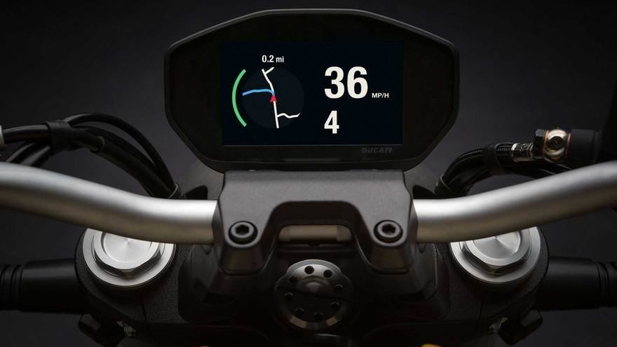
Digital Interface
DIGITAL INTERFACE
GPS tracking: The device fits into the vehicle and captures the GPS location information.
The tracking server has three responsibilities: Receiving data from the GPS tracking unit securely storing it, and serving this information on demand to the user.
A tracker may be placed on a vehicle to follow the vehicle's movements.

Slide 13
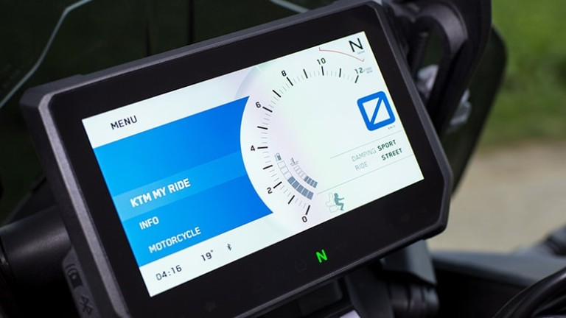
SPEEDOMETER
SPEEDOMETER
A Speedometer or a speed meter is a gauge that measures and displays the instantaneous speed of a vehicle.
By connecting the interface with the speedometer sensor,
we can display the speed of the vehicle digitally(user friendly mechanism).

Slide 14
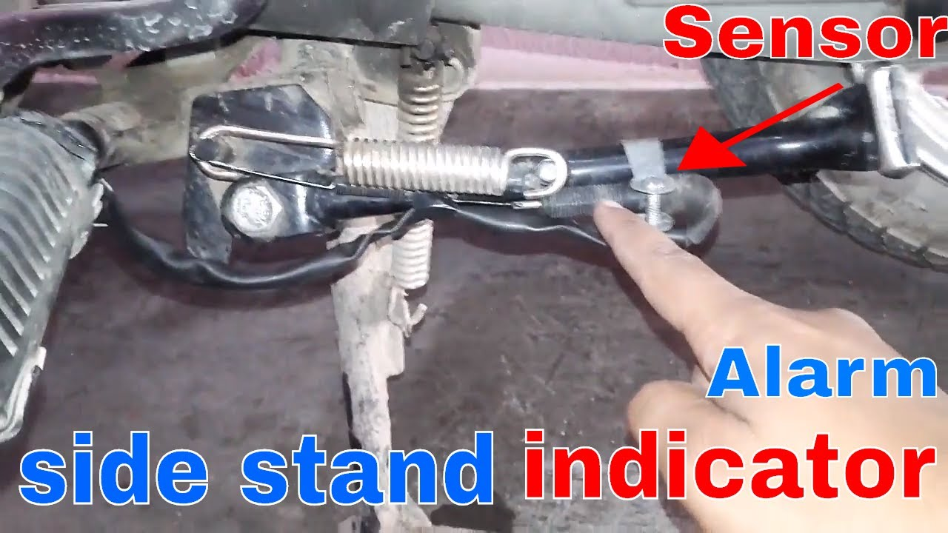
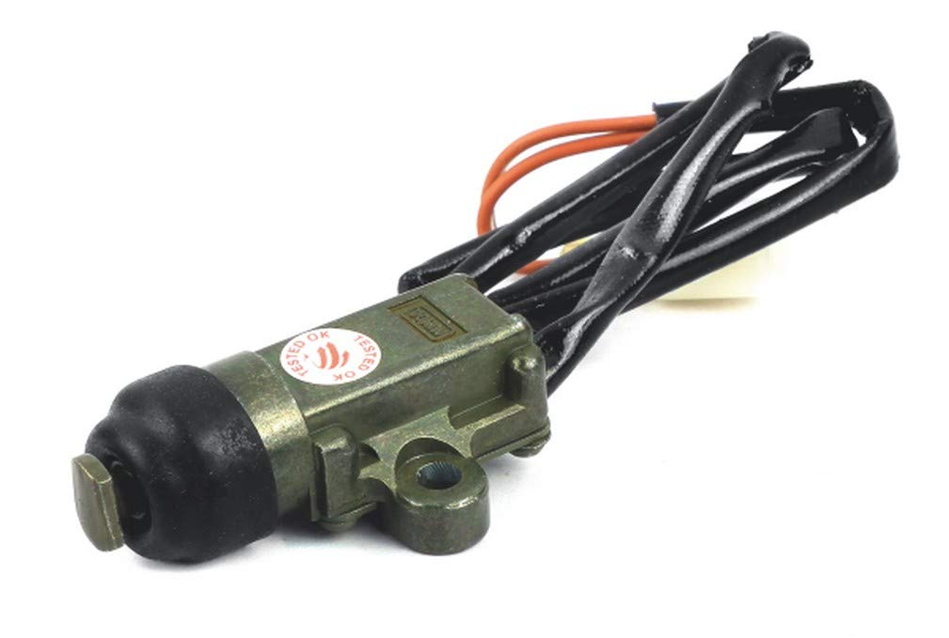
SIDE STAND ALARM

Slide 15
The side stand is used for supporting a parked Motorcycle it has some disadvantages.It takes place as while the driver starting the motorcycle, there may be possibility of forgetting to release the side stand. This will cause to unwanted troubles.
Then the undistracted stand hitting the ground and affected the riders control during the turn.
Forgetting to lift the side stand causes huge accidents in rural areas partly in urban areas too, because all the other source of accident has preventive measure, but accident due to side stand do not have proper preventive measure. If you see the accident status 36% of the accidents occur due to this problem.
The side stand sensor works in the following way:
When the ignition process of the vehicle is started, the sensor warns the rider by a buzzer to lift up the side stand which minimizes the possibility of forgetting the same.

Slide 16
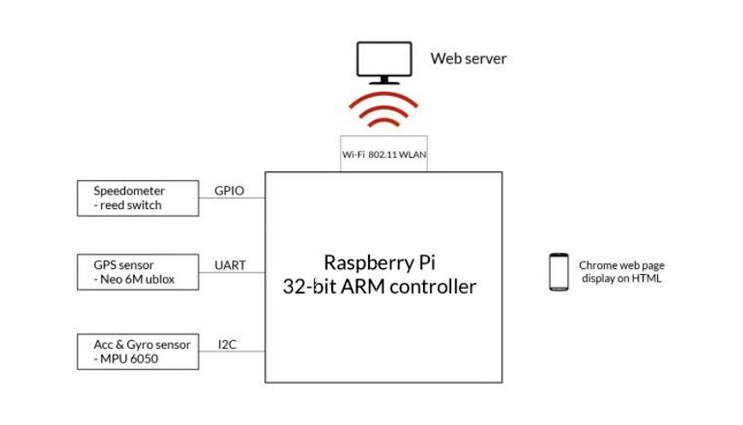
SYSTEM DESCRIPTION
SYSTEM DISCRIPTION

Slide 17
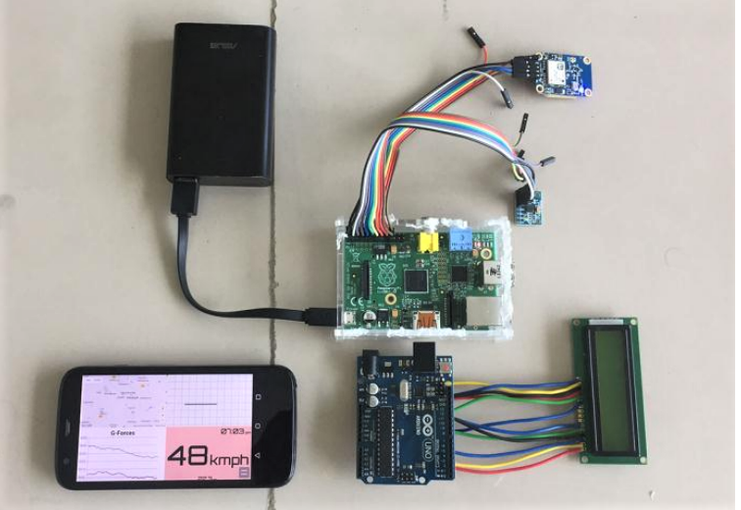
Raspberry Pi connections with sensors

Slide 18
This project is designed using a Raspberry PI single board computer used for embedded application. The Interfacing components used are Reed switch sensor, GPS Modem, Accelerometer and gyro sensor, WiFi Dongle . USB mouse and keyboard can be used for user-friendly usage of the Board. The 32-bit ARM controller on the Raspberry Device supports the Functionality as the CPU Core. Block diagram of informatics and infotainment system for an E-Bike.
The Linux OS is used as the Default operating system responsible for handling the tasks and peripheral on chip components. Python scripting is used for the programmingthe device and functionalities.
Reed switch is connected to raspberry pi GPIO pin, GPS module Neo 6M is connected via asynchronous UART communication, MPU 6050 Accelerometer and gyro sensor is connected via serial I2C interface.. The data from the sensors is processed and updated in a database file. The data is concurrently sent via sockets to a running web server through Wi-Fi module.

Slide 19
ADVANTAGES
A rider can access the digital dashboard on the vehicle which will display the current speed, trip distance, access calls.
GPS information is directly fed to a Google maps API which will locate the vehicle.
This integration makes sure that the side stand, which is responsible for around 36% of the accidents, is lifted as soon as the helmet is worn and the ignition is turned on.
If the rider is in crowded areas, the speed barriers acts and restricts the speed limit using Artificial Intelligence.

Slide 20
CONCLUSIONS
In this paper we have proposed an Informatics system for an E-Bike which displays the riding information on the screen
Major accidents can be avoided which makes this project a life saving mechanism.
To develop the intelligent smart systems, installing vehicle sensors and processing data from them is the key fundamental step.
There is a vast scope for research in this field as just the indication is not enough to ensure the safety of the rider since most of the time these warnings are ignored.

Slide 21
REFERENCES
[1] von Watzdorf, S., and Michahelles, F. 2010. Accuracy of positioning data on smartphones. In LocWeb 2010 Proceedings (Tokyo, Japan, November 29, 2010).
[2] Gusikhin, O., Rychtyckyj, N. & Filev, D. Knowl Inf Syst (2007) 12: 147. doi:10.1007/s10115-006-0063-1.
[3] "The Vehicle Interface Foundation" YouTube. YouTube, 29 April 2013. Web. 29 January 2017.
[4] Kristina, F., (2014), Implementing the connected e-bike: challenges and requirements of an IoT application for urban transportation,doi:10.4108/icst.urbiot.2014.257191.
[5] "Why Connectedness Will Go beyond Mobile Devices & Apps?" Ather Energy. Ed. Tavleen. N.p., 19 May 2016. Web. 04 Feb. 2017. [6] Shovic, John C. "Connecting an IOT Device to a Cloud Server - IOTPulse." Raspberry Pi IoT Projects (2016): 147-86. Web.

Slide 22
Thank You

